Slide 1

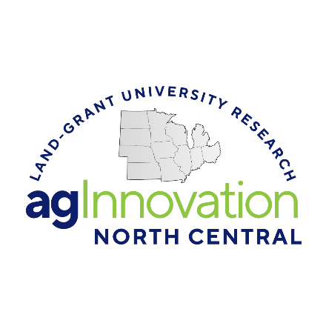
agInnovation North Central
Multistate Research
Insert Project #: Title Here
Name of AA to Project #
Meeting Date: XX/XX/XXXX

Slide 2
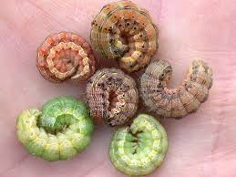
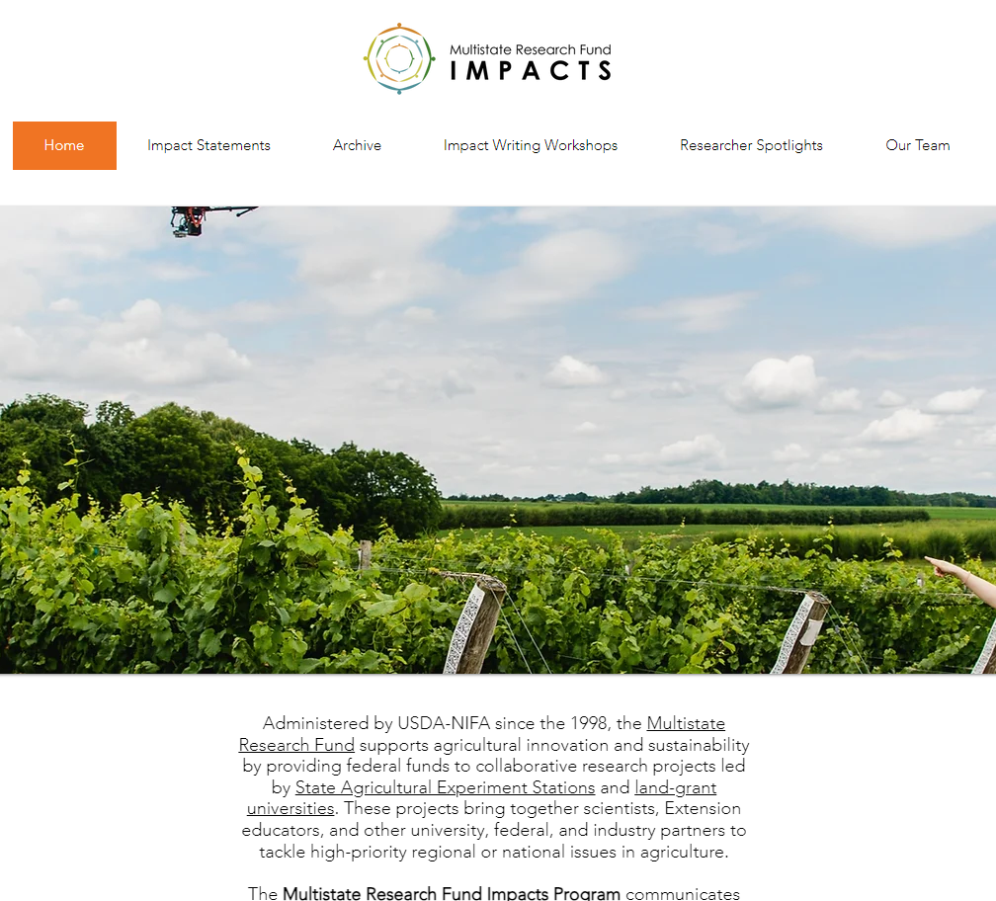

Multistate Research Projects—The Why
Multistate projects are one of the most unique and gratifying elements of the research enterprise of Land-grant universities.
Through broad and flexible criteria, scientists and educators have a recognized forum to collaborate and innovate with colleagues across the nation.
2025 agNC Excellence in Multistate Research Award Winner: NC246: Ecology and Management of Arthropods in Corn
https://www.mrfimpacts.org

Slide 3
Supporting Federal Legislation
1862
Morrill Act—Allows public lands to be used to establish “land grant colleges to teach agriculture”
1887
Hatch Act—Establishes Ag Experiment Stations
1946
Research and Marketing Act—Establishes multistate research, 25% set aside from Hatch funds for regional research.
agInnovation North Central established in 1947 as the NCRA!
1998
Agricultural Research, Extension, and Education Reform Act (AREERA)—Establishes the Multistate Research Fund (MRF), scientific peer review, and integrated research and extension activities.
Notes:
The Hatch Act, initiated in 1887, provides funding and broad directions on program focus to 1862 LGUs.
The size and scope of LGUs differs significantly coast-to-coast and border-to-border. Hence, as one might suspect, the evolution of programs and functions of the LGU has significantly evolved over time. The actual amount of ‘guidance’ provided to states has evolved over time and how the states superimpose their program priorities and direction has also evolved.
Within the Hatch appropriation, there are Hatch Regular funds and Hatch Multistate funds which have federally designated directives.
Rural population and farm numbers, state-specific compared to the national total, and coupled with a federal overhead rate of 3% comprise the actual ‘formula’ for distribution to states.
NIFA is supported by the 3% administration assessment.
Actual federal allocations are Congressionally-driven and signed off on by the Executive. While the USDA budget in its entirety is publicly available. In addition, for Hatch (Regular and Multistate) Funds the ACTUAL and FINAL appropriation as Appendix A to each state/DC and US insular areas is provided at: https://nifa.usda.gov/ and typing in “Hatch” in the keyword search. Identify the particular year of interest too. There generally is a lag in the year’s allocation that is publically available on the web.

Slide 4
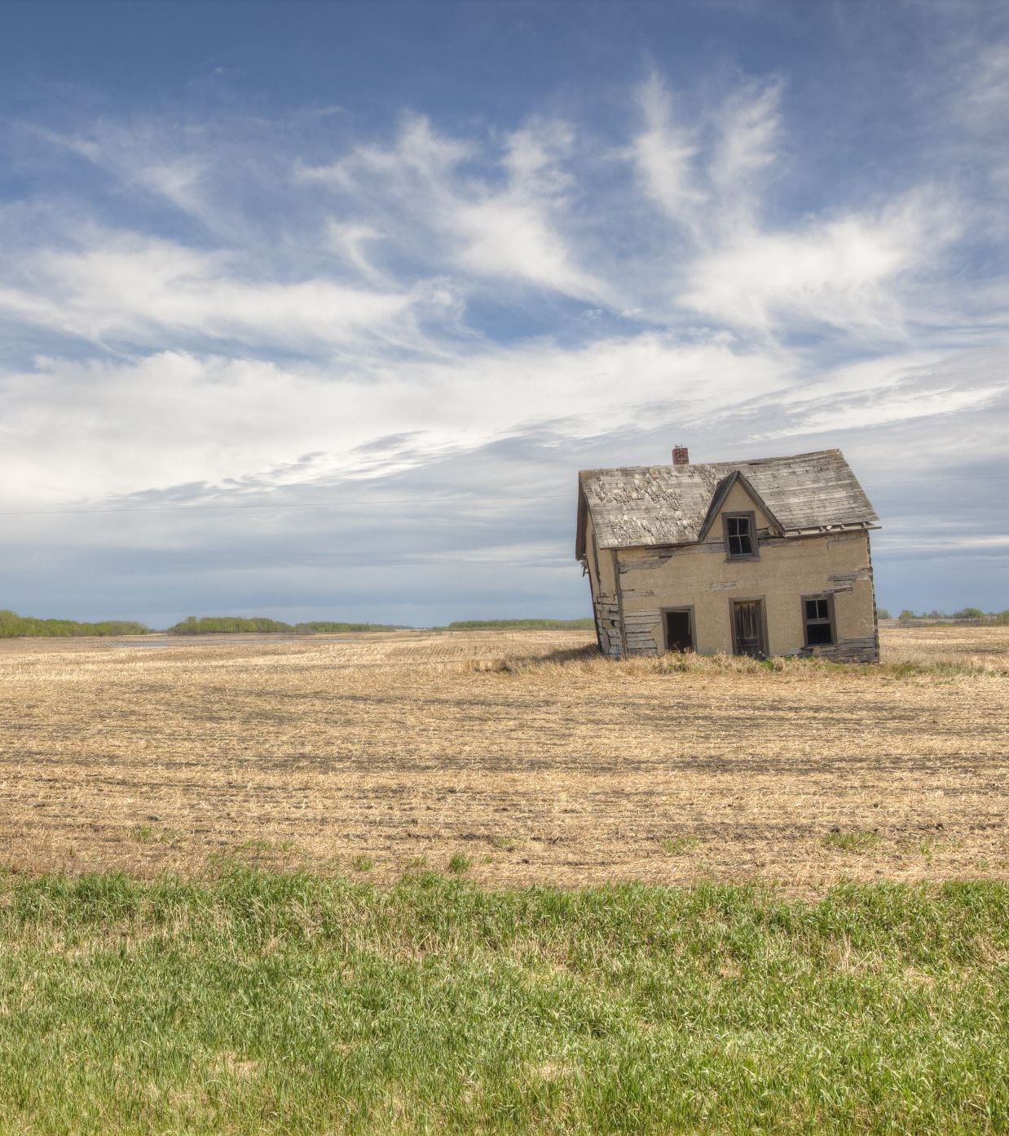
Research Capacity –
1862 Land-grant Universities
Hatch Act (1887)
…establishment of a department to be known and designated as an agricultural experiment station under direction of the 1862 LGU”
For FY1955 fixed base and if in excess of base then using a “formula”:
  20% equally to each State
  26% proportionate to relative rural in State to total rural population of all states
  26% proportionate relative farm population in State to total farm population of all states
  25% multistate, multidisciplinary, multi-institutional research and more than one state
  3% administration of the Act
Notes:
The Hatch Act, initiated in 1887, provides funding and broad directions on program focus to 1862 LGUs.
Within the Hatch appropriation, there are Hatch Regular funds and Hatch Multistate funds which have federally designated directives.
Rural population and farm numbers, state-specific compared to the national total, and coupled with a federal overhead rate of 3% comprise the actual ‘formula’ for distribution to states.
NIFA is supported by the 3% administration assessment.
Actual federal allocations are Congressionally-driven and signed off on by the Executive. While the USDA budget in its entirety is publically available. In addition, for Hatch (Regular and Multistate) Funds the ACTUAL and FINAL appropriation as Appendix A to each state/DC and US insular areas is provided at: https://nifa.usda.gov/ and typing in “Hatch” in the keyword search. Identify the particular year of interest too. There generally is a lag in the year’s allocation that is publically available on the web.

Slide 5
Research Capacity – 1862 Land-grant Universities
Hatch Act (1887) continued
Must be matched 1:1; Insular areas and DC have a 50% match
USDA Secretary may waive match for Insular and DC
Multistate research – at least 25% must be used to support multistate research
Integrated activities – 25% or 2X level spent in FY1997 (whichever is less) on activities that integrate research and Extension
1-year carryover; if not spent in the second year, then the amount is deducted from the following year’s allocation and the unspent funds are redistributed by formula
Notes:
The size and scope of LGUs differs significantly coast-to-coast and border-to-border. Hence, as one might suspect, the evolution of programs and functions of the LGU has significantly evolved over time. The actual amount of ‘guidance’ provided to states has evolved over time and how the states superimpose their program priorities and direction has also evolved.
All Hatch Act funds need to be matched at a minimum of 1:1 and most states leverage this federal amount by 5-10:1, so it is highly leveraged with the states making up the most significant proportion of the funds.
With some smaller institutions, the USDA Secretary of Agriculture can waive a portion of the match given extraordinary circumstances.
Regardless, the federal research support provides the foundation to conduct and compete for more resources.
A certain percentage MUST be multistate and a certain percentage must be integrated with Extension.
Hatch appropriations can used for total of two years only, otherwise they revert back to the U.S. Treasury.

Slide 6

Hatch Funding FFY26:
Nation and North Central Region (NCR)
FFY2026 Hatch Act--$265M to 57 institutions nationally (funded at FFY2024 & 25 levels)
  (minus federal administration and small business set asides, ~6%)
  NCR (12 institutions) total Hatch Regular: ~$57M
Hatch Multistate Research (at least 25% of Hatch Act) = $65M to 57 institutions nationally
  NCR (12 institutions) total Hatch Multistate: ~$16M

Slide 7

Required Reporting—Accountability and Results
1998 Agricultural Research, Extension, and Education Reform Act of 1998 (AREERA) amended capacity programs (Hatch Act of 1887, Smith Lever Act of 1914, and 1444 and 1445 of the National Ag Research, Extension, and Teaching policy Act of 1979) to require USDA-approved Plans of Work from each eligible SAES prior to the distribution of funds
AREERA also requires scientific peer review of all capacity funded research, including multistate and integrated research
State ag experiment station directors (SAES) have responsibility for the multistate research program and have delegated it to the regional associations.
Notes:
The multistate research program was created as an organized, trusted, "official" way to spend the required 25% so that states don't have to figure it out on their own. Just a possible helpful tidbit. This helps answer the "why" of the program and NIMSS.

Slide 8
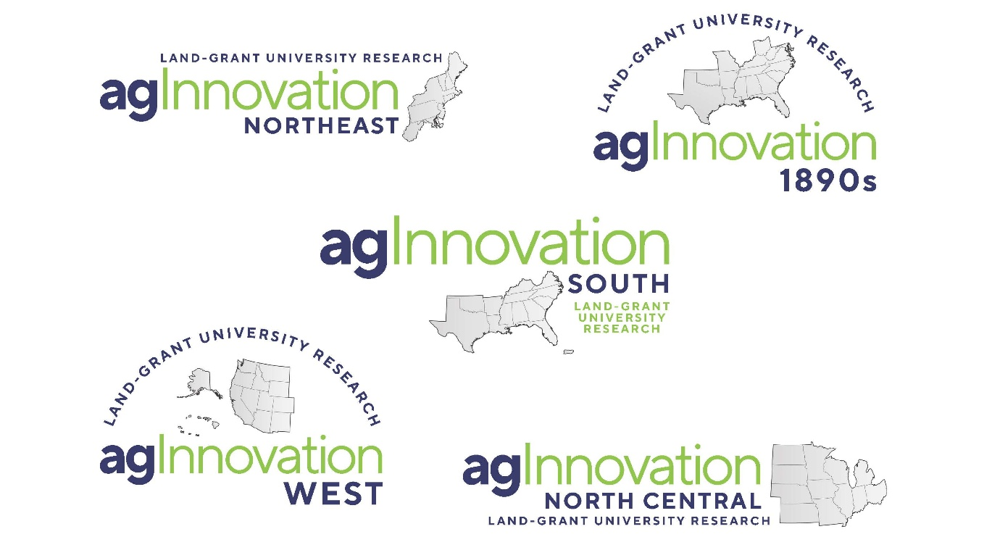
Role of Regional Associations or SAES Directors in Hatch Multistate Research Funding
4-1862 regional associations, 1-1890 regional association for research (equivalent number for Cooperative Extension regional associations)
Facilitate the cooperation, coordination, planning, and other management of regional and national food, agriculture and natural resources research*
  *1890, 1994, and some 1862 LGUs are not required by AREERA to have multistate research or integrated research and extension activities.
Management of regional multistate research includes:
  collect stakeholder input,
  establish research priorities,
  facilitate research collaboration, coordination,
  manage multistate research portfolio, including scientific peer review,
  establish regional partnerships,
  and other activities as needed.
Notes:
Membership open—other LGU, federal agencies, and other scientists are welcome to join these project teams.

Slide 9


agInnovation North Central
Promotes and facilitates collaboration, coordination and communication across agInnovation North Central Land-grant university members, partners, and stakeholders at the regional, national, and international levels.
12 Member Institutions
Established 1947
> 90 multistate research projects portfolio
NC specific projects have nationwide participation and topics cut across food, agriculture and natural resources topics
12 Directors of Ag Experiment Stations make up voting body
Current agInnovation North Central Chair - Dr. Derek McLean (10/1/2025 to 9/30/2026); Multistate Research Committee Chair (MRC) – Dr. Joleen Hadrich – Check with agNC office to make sure these names are correct!
Regional level initiatives and activities (e.g., new Administrator’s Bootcamp, North Central Ag Communicators Consortium, regional early and mid-career innovator and multistate awards, etc.)
Engage with Association of Public and Land-grant Universities (APLU) at the national level through service on budget, legislations and advocacy, science and technology, and other committees.

Slide 10

agInnovation North Central Office –
We are here to help! https:www.aginnovationnc.org
Jeanette Thurston—Executive Director
Christina (Chris) Hamilton—Assistant Director and regional NIMSS System Administrator
  Multistate specific activities:
      Oversees the NC Multistate portfolio
      Works with AAs to ensure projects meet annually and submit complete, on-time reports to NIMSS
      Assists AAs, committee members, and SAES staff with NIMSS
      Shares appropriate information from agInnovation North Central directors with AAs and committees
      Coordinates project review process for NC
      Informs NIFA that projects have been regionally approved, then NIFA assigns a representative.
agInnovation North Central WEBSITE HAS A LOT OF MULTISTATE PROJECT RESOURCES INCLUDING:
    NC virtual multistate project handbook, NRSP guidelines, and several other resources

Slide 11

Hatch Multistate Research
agNC Multistate Committee Overview
  NCs – Research (47)
  ERAs – Education (teaching and Extension) and Research Activity (18)
  DCs – Development Committees (1)
  CCs – Coordinating Committees (11)
  ACs – Advisory Committees (10)—typically membership consists of unit leaders (i.e., department heads/chairs, directors) in a specific discipline area(s)
  500s - Rapid Response (0)
NRSP’s – National Research Support Projects (7)
    “Off the top” funding before allocations to states

Slide 12
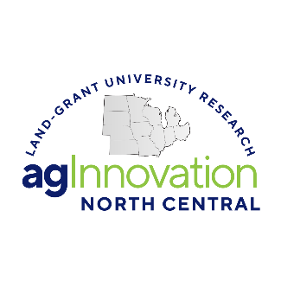

Hatch Multistate Research Committees
Research
(NC)
Development
(DC)
Coordinating
(CC)
Advisory
(AC)
Integrated Extension
(ERA)
Rapid Response
(500 series)
Regionally coordinated and membership not restricted*
  Financial support varies by institution
Funding focused on research committees
Multistate Committees are beneficial to members:
  Building networks and leadership opportunities for early career faculty
  Networking, strengthening relationships, and identifying collaboration and other opportunities
  Direct engagement with NIFA
  Updates at the federal, regional and state levels
  Financial support
  More details, next slide
Advisory Committees (AC), agInnovation North Central Multistate Research Committee (MRC), Administrative Advisors (AA), NIFA, committee chairs and the committees all help set the bar for achievement

Slide 13

Benefits of Multistate Research Committee's—Spread the Word!
Unique and timely topics for collaboration
Leverage facilities, equipment, expertise, databases, etc.
Project members may be familiar with grant programs, serve as journal editors, successful faculty members, reviewers for retention or promotion/tenure, etc.
Identifying and recruiting graduate students and postdocs
Engage with federal (including NIFA) and other stakeholders
Leadership opportunities
Professional development skills
Financial support (travel, salary and fringe, grad students, technicians, operations, etc.)—varies by institution
Modest accountability requirements—opportunities outweigh the time commitment (next slide)

Slide 14

Committee Responsibilities
  Participant appointment by your AES director
  Plan annual (or more) meetings (agenda, leadership, notes)
  Conduct meeting (tied to project objectives)
  Encourage broad participation with LGUs, non-LGUs, USDA ARS, other federal-state agencies, public and private sector
  Create annual (SAES-422s/termination) reports
    Multistate, collaborative work, outputs, impacts
    NIMSS (collect report data)
    MRF Impacts (impact reporting)
  Check out National Impact Database and MRF Impacts Reporting (another agInnovation North Central ppt presentation)
  Project renewal
  REEport/NRS is the individual SAES report, not an individual PI/faculty member
Notes:
Each SAES researcher on a research multistate creates their own individual project in REEport/NRS that contributes to the individual SAES report. This is in comparison to NIMSS where the reporting is committee based, not individual.

Slide 15
How do you (or your colleague) join a multistate committee?
Investigate individual multistate projects for applicability to your job and professional interests/capacities with project objectives
Anyone may join a multistate committee, yet financial access is only open to AES scientists
The AES director (or office) receives a faculty request to join a multistate project and makes the appointment
Information is required with Appendix E in NIMSS
Periodically the AA or more likely the regional association may assist

Slide 16

Project Reviews
Renewals and new projects reviewed by AA
Active projects have midterm review by AA
NCAC (NC Advisory Committee) of heads/chairs conduct scientific disciplinary review OR 2-3 experts are selected as peer reviewers if we don’t have an NCAC in the field (i.e., human sciences, forestry)
NC MRC (Multistate Research Committee) does individual and collective reviews considering AAs, NCAC/Experts resulting in recommendations to agInnovation North Central
Notes:
Multistate research committees don’t have to submit a midterm report! At midterm review time, agInnovation North Central Multistate review committee and appropriate NCACs are only evaluating the existing annual reports.

Slide 17
agInnovation North Central Timeline:
5-Year Multistate Research Project
15 Sep.
Request to write a proposal with AA identified
15 Oct.
Upload proposal objectives
15 Nov.
All committee participants added by AES office
1 Dec.
Full 5-year project proposal due in NIMSS
15 Dec.
AA project proposal reviews due in NIMSS
January
NCAC and MRC reviews conducted
April
Final review and agInnovation North Central recommendations provided
1 June
All revisions completed
July
agInnovation North Central final recommendations
Sep. 30/Oct 1
Old project expires/New and renewal projects begin 5-year cycle

Slide 18
This Multistate Committee’s Timeline
Project start/end dates: Check NIMSS for these dates
Midterm review occurred early in:
Renewal proposal due:
Annual report due (60 days after meeting):
Needed updates to NIMSS editor or technical team (incoming chair?)?
  Send updates to Chris Hamilton, chamilton@wisc.edu!
  Editors/Technical Leaders –
  Admin Advisor (AA) –
Notes:
Update here with your project’s dates. Check with the agInnovation North Central office if you’re not sure!

Slide 19

Questions?

