Slide 1

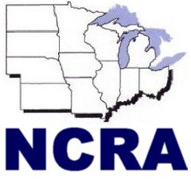
agInnovation North Central (agNC)
Multistate Research
[NCAC ## and TITLE HERE]
[NAME], Administrative Advisor (AA) for NCAC##
[Date]

Slide 2
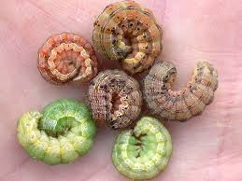
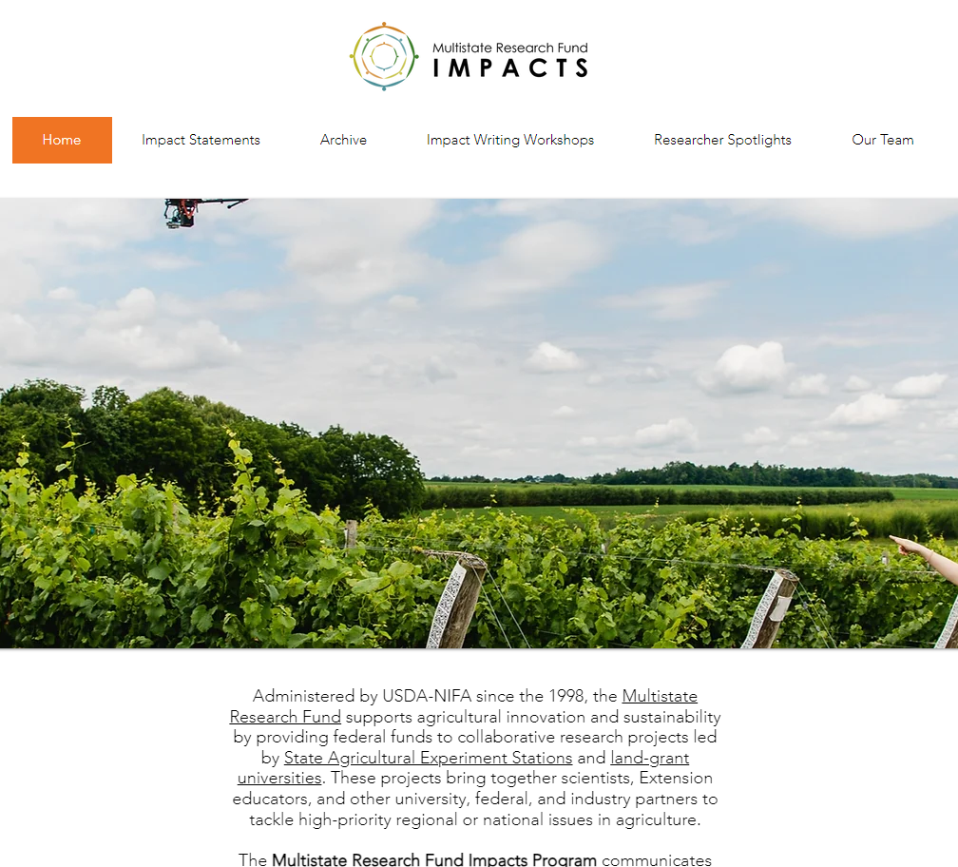
Multistate Research Projects—The Why
Multistate projects are one of the most unique and gratifying elements of the research enterprise of Land-grant universities.
Through broad and flexible criteria, scientists and educators have a recognized forum to collaborate and innovate with colleagues across the nation.
Making a Difference
2025 agNC Excellence in Multistate Research Award Winner: NC246: Ecology and Management of Arthropods in Corn
https://www.mrfimpacts.org

Slide 3

Why do we need NCACs?
North Central Advisory Committees advise the NCR Ag Experiment Station Directors
Provide scientific expertise, science priority recommendations, and review of NC multistate research projects (existing and proposed)
Provide a venue for connection, coordination, and collaboration of leadership across our region
  Including updates from USDA-NIFA or others
Membership consists of unit leaders (i.e., department heads/chairs, directors) in a specific discipline area(s)

Slide 4

Required Reporting—Accountability and Results
1998 Agricultural Research, Extension, and Education Reform Act of 1998 (AREERA) amended capacity programs (Hatch Act of 1887, Smith Lever Act of 1914, and 1444 and 1445 of the National Ag Research, Extension, and Teaching policy Act of 1979) to require USDA-approved Plans of Work from each eligible SAES prior to the distribution of funds
AREERA requires scientific peer review of all capacity funded research, including multistate and integrated research
State ag experiment station directors (SAES) have responsibility for the multistate research program and have delegated it to the regional associations.
Notes:
The multistate research program was created as an organized, trusted, "official" way to spend the required 25% so that states don't have to figure it out on their own. Just a possible helpful tidbit. This helps answer the "why" of the program and NIMSS.

Slide 5
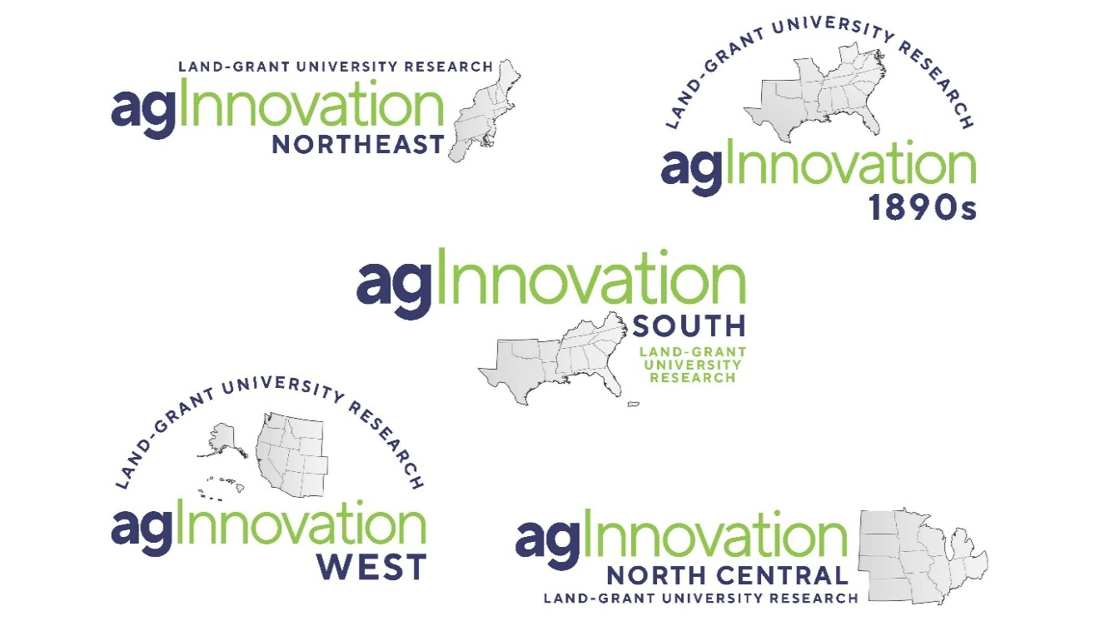
Role of Regional Associations or SAES Directors in Hatch Multistate Research Funding
4-1862 regional associations, 1-1890 regional association for research (equivalent number for Cooperative Extension regional associations)
Facilitate the cooperation, coordination, planning, and other management of regional and national food, agriculture and natural resources research*
  *1890, 1994, and some 1862 LGUs are not required by AREERA to have multistate research or integrated research and extension activities.
Management of regional multistate research includes:
  collect stakeholder input,
  establish research priorities,
  facilitate research collaboration, coordination,
  manage multistate research portfolio, including scientific peer review,
  establish regional partnerships,
  and other activities as needed.
Notes:
Membership open—other LGU, federal agencies, and other scientists are welcome to join these project teams.

Slide 6

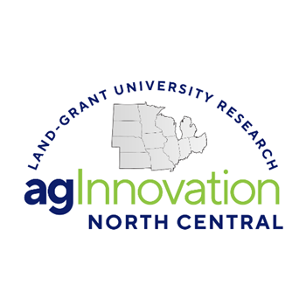
agInnovation North Central (agNC)
Promotes and facilitates collaboration, coordination and communication across agNC Land-grant university members, partners, and stakeholders at the regional, national, and international levels.
12 Member Institutions
Established 1947
> 90 multistate research projects portfolio
NC specific projects have nationwide participation and topics cut across food, agriculture and natural resources topics
12 Directors of Ag Experiment Stations make up voting body
Current agInnovation North Central Chair - Dr. Shibu Jose (10/1/2024 to 9/30/2025); Multistate Research Committee Chair (MRC) – Dr. Derek McLean
Regional level initiatives and activities (e.g., new Administrator’s Bootcamp, North Central Ag Communicators Consortium, regional early and mid-career innovator and multistate awards, etc. )
Engage with Association of Public and Land Grant Universities (APLU) at the national level through service on budget, legislations and advocacy, science and technology, and other committees.

Slide 7

agInnovation NC Office- We are here to help! https:www.aginnovationnc.org
Jeanette Thurston—Executive Director
Christina (Chris) Hamilton—Assistant Director and regional NIMSS System Administrator
  Multistate specific activities:
      Oversees the NC Multistate portfolio
      Works with AAs to ensure projects meet annually and submit complete, on-time reports to NIMSS
      Assists AAs, committee members, and SAES staff with NIMSS
      Shares appropriate information from agNC directors with AAs and committees
      Coordinates and ensures a timely project review process
      Informs NIFA that projects have been regionally approved
agNC WEBSITE HAS A LOT OF MULTISTATE PROJECT RESOURCES INCLUDING:
    NC virtual multistate project handbook, NRSP guidelines and several other resources

Slide 8

Hatch Multistate Research 101
agNC Multistate Committee Overview
  NCs – Research (~49)
  ERAs – Education (teaching and Extension) and Research Activity (~18)
  DCs – Development Committees (2)
  CCs – Coordinating Committees (12)
  ACs – Advisory Committees (11)—typically membership consists of unit leaders (i.e., department heads/chairs, directors) in a specific discipline area(s)
  500’s - Rapid Response (0)
NRSP’s – National Research Support Projects (6)
    “Off the top” funding before allocations to states

Slide 9
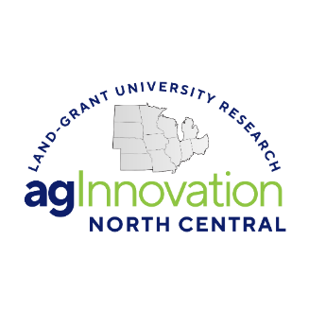
Hatch Multistate Research Committees
Research
(NC)
Development
(DC)
Coordinating
(CC)
Advisory
(AC)
Integrated Extension
(ERA)
Rapid Response
(500 series)
Regionally coordinated and membership not restricted*
  Financial support varies by institution
Funding focused on research committees
Multistate Committees are beneficial to members:
  Building networks faculty, post docs, grad students
  Leadership opportunities for early career faculty
  Networking, strengthening relationships, and identifying collaboration and other opportunities
  Direct engagement with NIFA
  Updates at the federal, regional and state levels
  Financial support
Advisory Committees (AC), agNC Multistate Research Committee (MRC), Administrative Advisors (AA), NIFA, committee chairs and the committees all help set the bar for achievement

Slide 10

Hatch Funding FY24:
Nation and North Central Region (NCR)
FY2024 Hatch Act--$265M to 57 institutions nationally
  (minus federal administration and small business set asides, ~6%)
  NCR (12 institutions) total Hatch Regular: ~$57M
Hatch Multistate Research (at least 25% of Hatch Act) = $65M to 57 institutions nationally
  NCR (12 institutions) total Hatch Multistate: ~$16M
*FY2025 funding is expected to remain at FY2024 levels.

Slide 11

Multistate Research Project Reviews
Renewals and new projects reviewed by AA
Active projects have midterm review by AA
NCAC (NC Advisory Committee) of heads/chairs conduct scientific disciplinary review new projects, progress, and renewals
NC MRC (Multistate Research Committee) does individual and collective reviews considering AAs, NCAC/Experts resulting in recommendations to agNC
Notes:
Multistate research committees don’t have to submit a midterm report! At midterm review time, NCRA Multistate review committee and appropriate NCACs are only evaluating the existing annual reports.

Slide 12

NCAC Committee Responsibilities
  Member appointment by their Ag experiment station director
  Work with AA to schedule and plan annual meeting (in-person or virtual)
  Annual meeting:
    identify NCAC leadership,
    conduct project reviews/discussion,
    identify potential National Excellence in Multistate Award nominees,
    discuss time and place of future meetings,
    state updates/sharing of new programs/challenges/activities
  Submit reviews in NIMSS, meeting report (due 60 days after meeting)
Notes:
Each SAES researcher on a research multistate creates their own individual project in REEport/NRS that contributes to the individual SAES report. This is in comparison to NIMSS where the reporting is committee based, not individual.

Slide 13
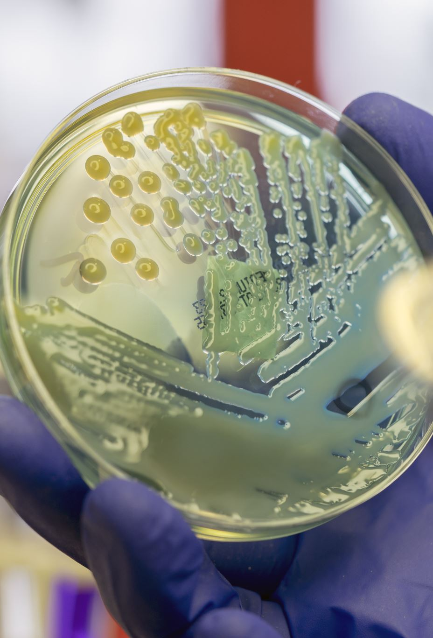
NCACXX-Related NC Multistate Research Projects
Get a list from the agNC office or check on https://www.aginnovationnc.org/ - Multistate & AA Resources >> Current NC projects

Slide 14
agNC Timeline:
5-Year Multistate Research Project
15 Sep.
Request to write a proposal with AA identified
15 Oct.
Upload proposal objectives
15 Nov.
All committee participants added by AES office
1 Dec.
Full 5-year project proposal due in NIMSS
15 Dec.
AA project proposal reviews due in NIMSS
January
NCAC and MRC reviews conducted
April
Final review and agNC recommendations provided
1 June
All revisions completed
July
agNC final recommendations
Sep. 30/Oct 1
Old project expires/New and renewal projects begin 5-year cycle
NCAC reviews are assigned by Chris Hamilton in December
Meeting conducted and reviews completed, ideally, before February 15

Slide 15
NCACXX—Moving Forward
Chair? Chair-elect?
Secretary?
In-person or virtual meeting?
  Best dates?
  Where?
NIFA Rep:
Reach out to department heads at other NC (and beyond!) institutions & ask to join!

